Slide 1

DSCI425 Final Project
Jose Ortega

Slide 2
Regression Problem: Energy Efficiency
UCI Machine Learning Repository:
2 Responses:
"Heating Load“
"Cooling Load"
Variables:
"Relative Compactness“
"Surface Area"
"Wall Area“
"Roof Area"
"Overall Height“
"Orientation"
"Glazing Area“
"Glazing Area Distribution"

Slide 3
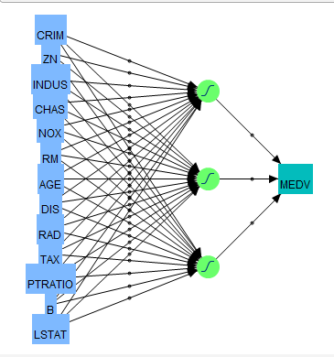
Neural Net

Slide 4
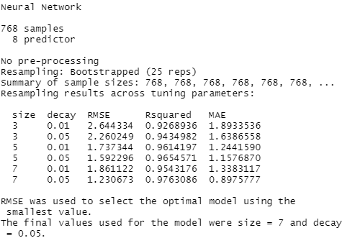
Neural Net for Heating Load

Slide 5
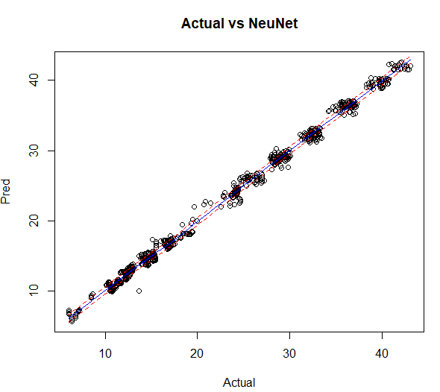
Neural Net for Heating Load

Slide 6
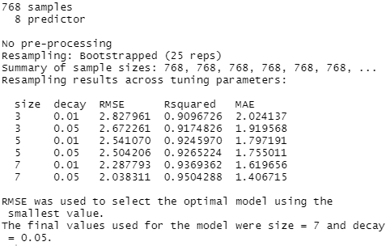
Neural Net for Cooling Load

Slide 7
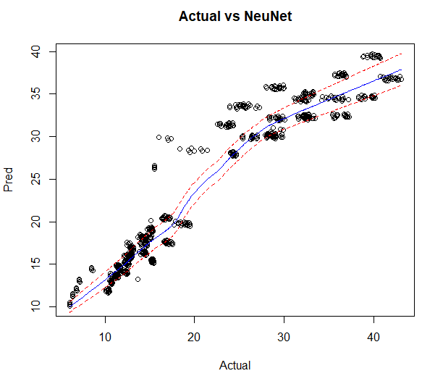
Neural Net for Cooling Load

Slide 8
Classification Problem: Wine quality
Variables:
"Alcohol”
"Malic acid“
"Ash"
"Alkalinity of ash“
"Magnesium“
"Total phenols”
"Flavanoids"
"Nonflavanoid phenols“
"Proanthocyanins“
"Color intensity“
"Hue“
"OD280/OD315 of diluted wines“
"Proline"
UCI Machine Learning Repository:
2 Responses:
Class/Type of Wine

Slide 9
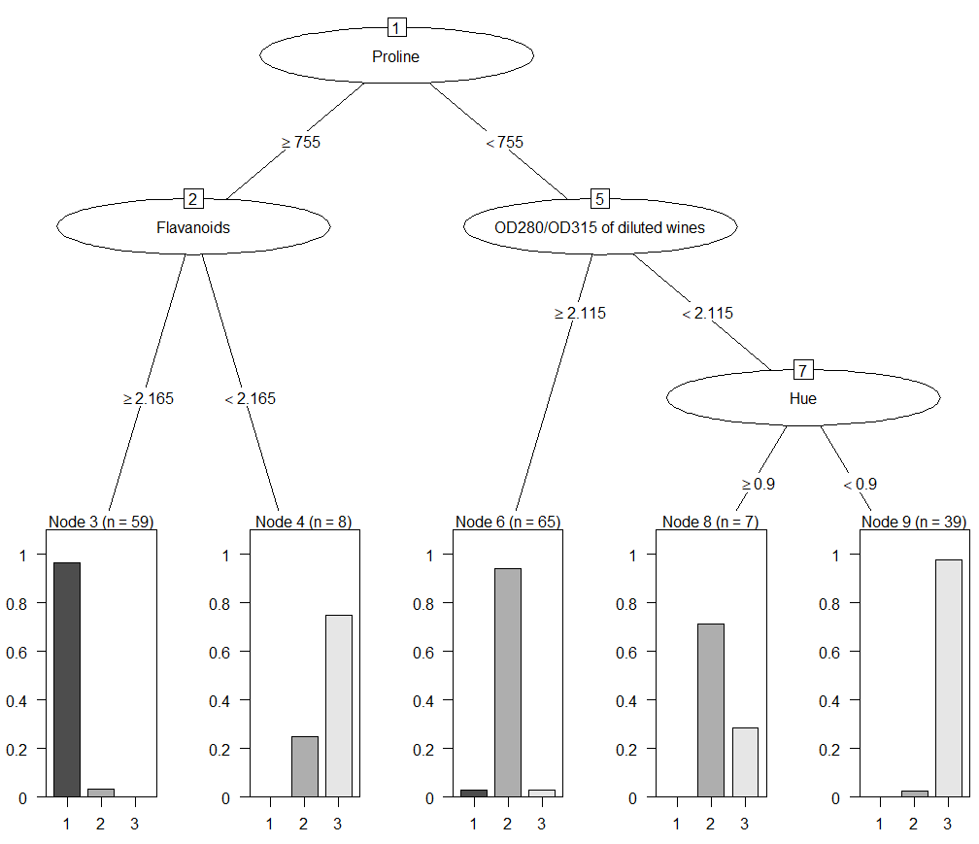
Classification Tree

Slide 10
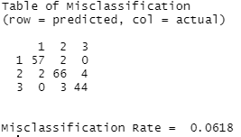
Classification Tree

